Slide 1
Agile Process
Sanket Shrestha

Slide 2
Agile Software Development
Group of software development methodologies based on iterative and incremental development
Develop a system through repeated cycles (iterative) and in smaller portions at a time (incremental)
Requirements and solutions evolve through collaboration between self-organizing, cross-functional teams

Slide 3
Scrum
Iterative, incremental framework for Project Management
Originally suggested for managing product development projects

Slide 4
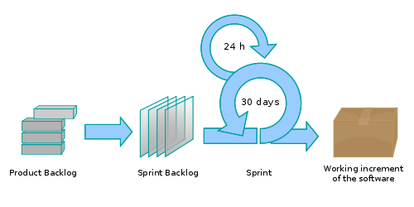
Scrum

Slide 5
Product Backlog
Business needs are dispatched into requirements
Writing requirements as “user stories”
Use of story card
3 Questions
As a …………………………. (who wants this piece of functionality)
I need ………………………. (What the user want)
So that …………………….. (Why the user wants it)

Slide 6
Sprint
One iteration of development, at the end of which a workable product is ready (1 month)
Sprint planning meeting
Defining goals
Team commitment
Sprint backlog - List of work team targeting for next sprint

Slide 7
Daily Scrum
Duration – 15 minutes
Stand-up (same place, same time)
3 Questions
What did I do since the last scrum?
What will I do today?
What are my impediments?

Slide 8
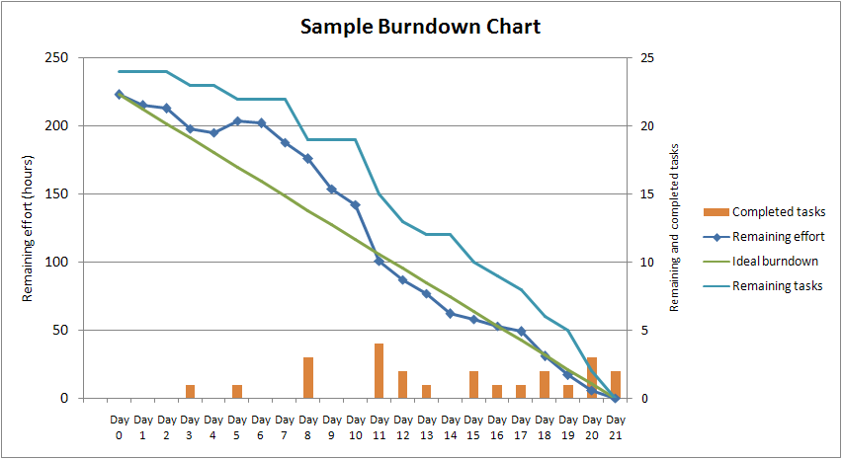
Burn Down Chart

Slide 9
Roles
Scrum Master - who maintains the processes (typically in lieu of a project manager)
Product Owner - who represents the stakeholders and the business
The Team - a cross-functional group who do the actual analysis, design, implementation, testing, etc.

Slide 10
Agile Methods
Agile Unified Process (AUP)
Dynamic Systems Development Method (DSDM)
Extreme Programming (XP)
Feature Driven Development (FDD)

Slide 11
Thank you

